Slide 1
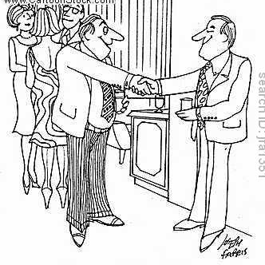
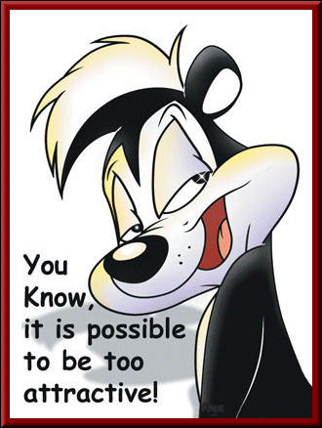
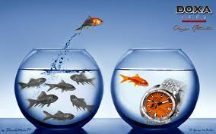
Attraction
“I knew we had a lot in common, I’m crazy too!”

Slide 2
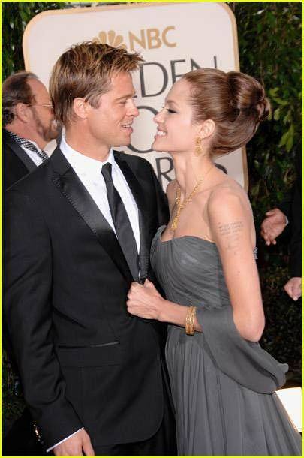
Attraction and Relationships
Relatively new to social psychology
Psychologists generally only focus on individuals
Romance and attraction isn’t a ‘scholarly’ thing to study
Relationships have a number of important health benefits.

Slide 3

Ideal Qualities in a Romantic Partner
1 | 2 | 3
Less than me | About the same as me | More than me
1 | Extraversion
2 | Conscientiousness
3 | Agreeableness
4 | Openness
5 | Neuroticism
6 | Age
7 | Height
8 | Education
9 | Intelligence
10 | Good Looks
11 | Social Status
12 | Spirituality
13 | Dominance
Notes:
Have students get out a piece of paper and rank order the importance of all of the traits. After they have ranked them, have students write down if they would like their partner to have more, the same or less of the following 13 traits. After several minutes, please get into your small groups to discuss. (Give students several minutes to complete the activity before they get into their small groups).
Have them discuss in small groups why they made the ratings they did.
(note: This might be a good opportunity to use the interactive clickers to see how the class as a whole responded.)
Do we always want similarity or are there some traits we would like our partners to differ?
When we desire differences is it because we either lack those qualities our selves or fear that too much of the same trait will clash and cause problems.
Which traits are the most important that our partners are similar?

Slide 4
Overview
What leads to attraction?
Proximity
Mere exposure
Physical attractiveness
Similarity
Matching
Mimicry

Slide 5
Psychological Attraction
Physical Proximity
Personal Rewards (Reciprocal Liking)
Attitude Similarity
Physical Appearance

Slide 6
Implicit Egotism
Liking things or people who are associated with ourselves in superficial ways
Birthdays, name similarity, any similarity ☺, age, religion and race, emotional experience, sense of humor, intelligence, morning or evening person

Slide 7
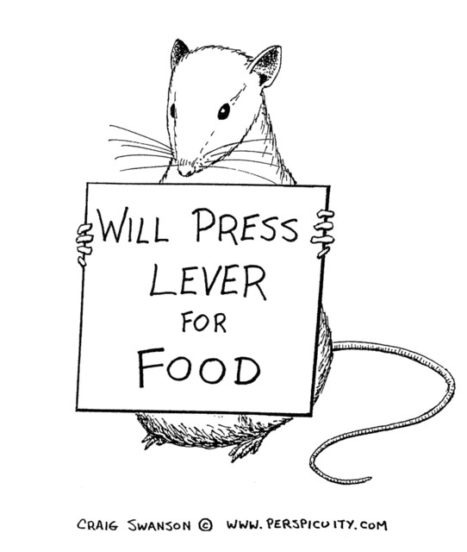
Classical Conditioning
You will like people with whom you associate positive things.
Dislike those with whom we
associate negative things
(escape conditioning).

Slide 8
Self-Verification
People with positive self-concepts prefer positive feedback and people with negative self-concepts prefer negative feedback.
Choose partners who evaluate them favorably or negatively

Slide 9
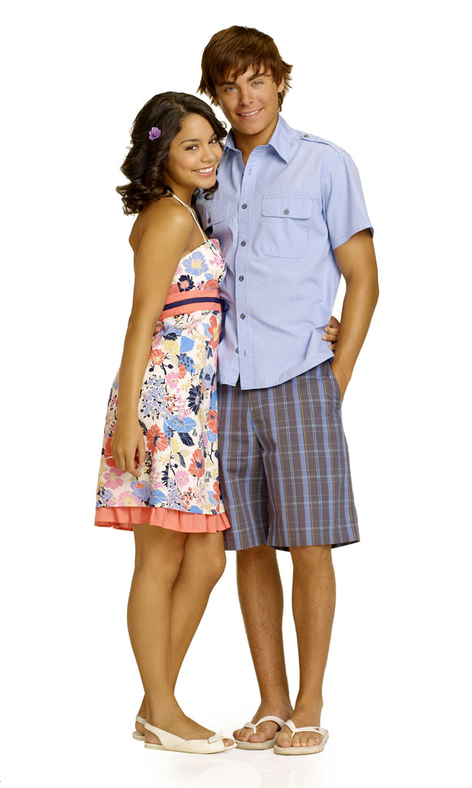
Attraction-Proximity
Proximity: We tend to like people who are closer to us
Festinger et al. (1950s): friendship patterns in dormitories
Closer friends with people who lived near
Notes:
In a classic study done at MIT in the 1950’s, Festinger, Schachter, & Back, 1950) examined the friendship patterns among couples living in two student housing complexes. They found that those couples who lived closer to one another were more likely to become friends than the couples who lived in apartments located further apart. That is, when asked to name their friends, 65% of the people mentioned lived in the same apartment building. In addition, 41% of next-door neighbors said that they were close friends, 22% of those who lived two doors apart said that they were close friends, and only 10% of those who lived on opposite ends of the halls indicated the same. Thus the closer people live to each other, the more likely they are to become friends. Among these students, proximity was a better predictor of friendships than were any conventional wisdom factors.
Segal (1974) examined Maryland state police trainees grouped together alphabetically. The closer the two trainees last names were in the alphabet the more likely they were to name each other as friends.
Proximity in alphabet was more predictive of friendship than similarity of race religion, age etc.

Slide 10
Proximity
Why do you think proximity increases attraction?
1) More opportunities to meet, interact
2) People are likely to live near people of similar economic, social backgrounds
3) Mere exposure

Slide 11
Preferred Qualities in Partners (Buss et al., 1986)
Women | Men
1) Kind/understanding | Kind/understanding
2) Exciting Personality | Exciting Personality
3) Intelligent | Intelligent
4) Healthy | Physically Attractive
5) Easy Going | Healthy
6) Physically Attractive | Easy Going

Slide 12
Similarity
Couples tend to be similar in age, race, religion, social class, personality, education, intelligence, physical attractiveness, and attitudes
Personality similarity related to marital happiness.
Perceived similarity more strongly associated with marital satisfaction than actual similarity
Notes:
there is a great deal of evidence that shows that we will be more attracted to someone we believe has attitudes similar to our own than to someone we believe is attitudinally dissimilar.
Couples tend to be similar in age, race, religion, social class, personality, education, intelligence, physical attractiveness, and attitudes
Personality similarity related to marital happiness.
Perceived similarity more strongly associated with marital satisfaction than actual similarity

Slide 13
Similarity
Why do we like people like us?
Why does similarity increase relationship satisfaction?

Slide 14
Proportion of Similarity
Proportion of similarity
Turns attraction into mathematics!
Divide topics of similarity by total number of topics discussed
The higher the outcome (ratio), the greater the attraction
Try weaving that into your wedding vows someday!!

Slide 15
Or…
Repulsion hypothesis – we aren’t attracted to similarity, but we are repulsed by dissimilarity.

Slide 16
Mimicry-Similarity in Behavior
When we want to belong to a group or want others to like us, we mimic their behavior.
We like people who mimic our behavior.
But don’t be too obvious!!!

Slide 17
Mimicry: Similarity in Behavior
Behavioral Mimicry
Notes:
Insert ABC video

Slide 18
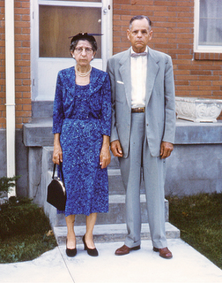
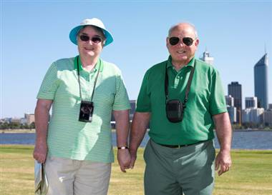
People get more similar over time
Zajonc et al. (1987)
Dissimilar looking couples at marriage look more similar 25 years later.
Happier couple look more similar
Decades of shared emotions?
Notes:
Zajonc proposes that people, often unconsciously, mimic the facial expressions of their spouses in a silent empathy and that, over the years, sharing the same expressions shapes the face similarly.
''Facial mimicry allows a truer empathy because it triggers the same inner state,'' Dr. Zajonc said. ''Couples can understand each other much better when this happens.''
''Common life experiences over years and years can alter facial musculature and wrinkle patterns, leading to an increased resemblance, '' said Paul Ekman,
Like other muscles of the body, facial muscles grow or atrophy according to the amount of use; facial muscle activity, in turn, stimulates growth in facial bones. People who maintain a particular emotional stance toward life - such as fear, disdain or joy - may tend to hold the facial muscles involved in those feelings slightly tensed in a readiness to respond, according to Dr. Ekman. Over several decades, that tension can come to give the face a distinctive cast by altering wrinkle patterns, changing the relative size of different muscles and even bones, and so altering the contours of the face.
Such a process is likely to occur in a married couple, according to Dr. Ekman. ''There is no question that we unwittingly use our facial muscles in the same way as the person we are looking at,'' he said.

Slide 19
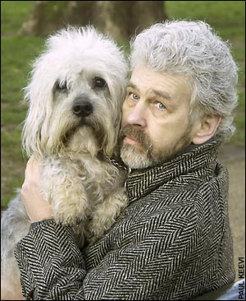
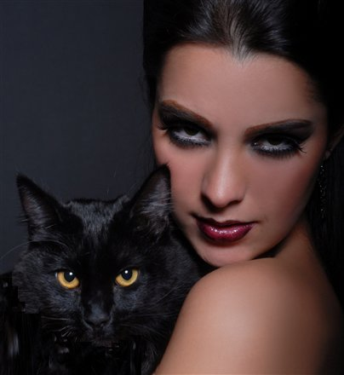
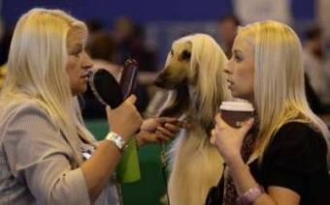
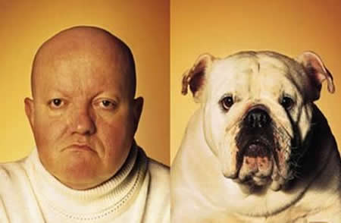
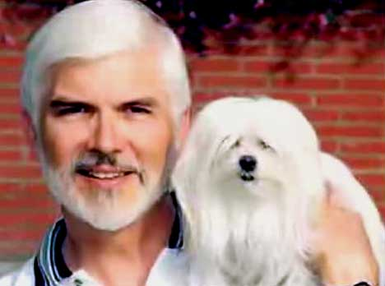
Similarity to Pets
Notes:
We are basically in love with ourselves so people may choose pets that resemble themselves
Or people and their pets appearance converge over time
Roy and Christenfeld (2004) People with purebred dogs look more alike due to selection and deliberation
No correlation with length of time owned and similarity.

Slide 20
When all else fails…
Misattribution of arousal
Secret Relationships
Increased arousal
Cognitive operations
Suppressing thoughts about someone can lead to preoccupation
Rebound effect
Notes:
Ok, so if all else fails—you’ve moved closer to your crush, you keep inexplicably keep running into them (mere exposure), you try to look as physically attractive as possible, you mimic their behavior—if you’ve done all these tricks, there’s still one more you can try. Remember our discussion in emotion on the misattribution of arousal? Remember how the men who crossed the high scary bridge were more likely to call the researcher and somehow saw more sex themes when looking at an ambiguous picture. Try that! Take your date somewhere exciting, somewhere sure to get the adrenaline pumping. Why do you think they always do this kind of date on the bachelor?
Show from the Bachelor.

Slide 21
Conclusions-Summary
Many factors contribute to attraction
Proximity
Physical attractiveness (matching)
Similarity
Importance of personality similarities
Mimicry → increased liking
We become more similar to our partners over time

